Slide 1
Legal Work Forecast
Humza Azhar Butt

Slide 2

Introduction
Background
WHO: Canadian Industry Statistics is an organization that analyzes industry data using the most recent data from Statistics Canada.
WHERE: Statistics Canada is a government agency that is commissioned to producing statistics to help better understand Canada.
Driving Questions
Which industries may be trending towards a growing need for legal work?
Provide unique insights from datasets provided. Focus insights to three industries only and explain why?
Selected Industries
Oil
Finance
Healthcare
Background
Approach
Environment
Social
Governance
Conclusion

Slide 3
ESG Approach
“ESG stands for Environmental, Social, and Governance. Investors are increasingly applying these non-financial factors as part of their analysis process to identify material risks and growth opportunities.” -CFA Institute
Determinants of Litigation
ESG Risk Events
ESG Risk Event | Date | 1-Year (%)
Energy accounting scandal | 8/14/01 | -99.6
Telecommunications scandal | 3/11/02 | -98.6
Upper Big Branch Mine explosion | 4/5/10 | -52.7
Deepwater Horizon oil spill | 4/20/10 | -28.2
Automobile airbag recall | 1/21/14 | -53.5
Pharmaceutical accounting scandal | 8/5/15 | -91.5
Automobile emissions scandal | 9/20/15 | -26.4
Average loss to shareholders after 1 year |  | -64.4
Demographic Changes
Business Cycle Fluctuations
Privatization and Trade Liberalization
Socio-cultural changes (Moral values, Alienation, Labor Contracts)
Background
Approach
Environment
Social
Governance
Conclusion
Notes:
Sources: IBIS World, Macroeconomic Development and Civil Litigation (Gerhard Clemenez & Klaus Gugler)
https://www.morganstanley.com/im/publication/insights/investment-insights/ii_esgandthesustainabilityofcompetitiveadvantage_us.pdf

Slide 4
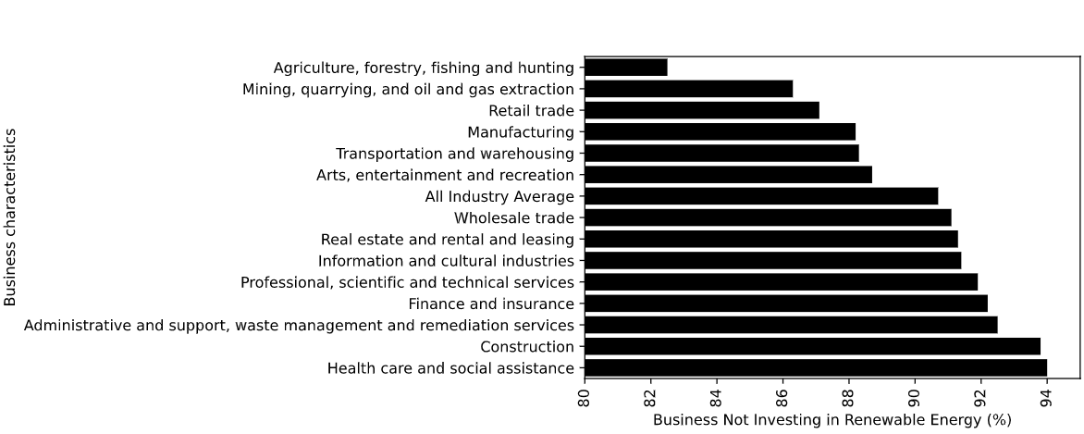
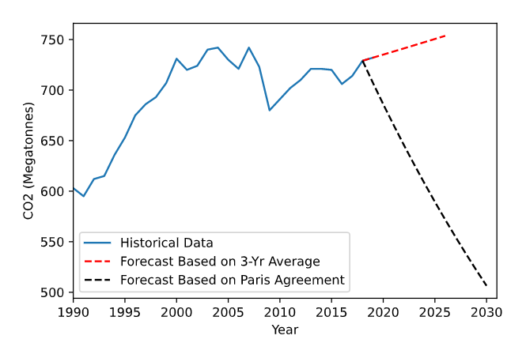
Environment
Key Insights
Investment in Climate Change 2020
Canada has agreed to lower CO2 emissions to 511 Mt by 2030.
Requires them to enact regulation to reverse 0.417% 3-yr average growth to -3%.
Oil industry invests well above all industry average in terms of investment into renewable energy.
As climate change becomes more prevalent, this industry is likely to face legal backlash in the near future.
CO2 Emissions 1990-2019 Forecasting
*Paris Agreement: 511 Megatonnes by 2030
Background
Background
Environment
Approach
Social
Environment
Governance
Social
Other
Governance
Conclusion
Conclusion
Notes:
3-year average 0.417% increase
3% decrease per year to reach paris target
Sources: Canada At a Glance 2020, Climate change investments, by business characteristics

Slide 5
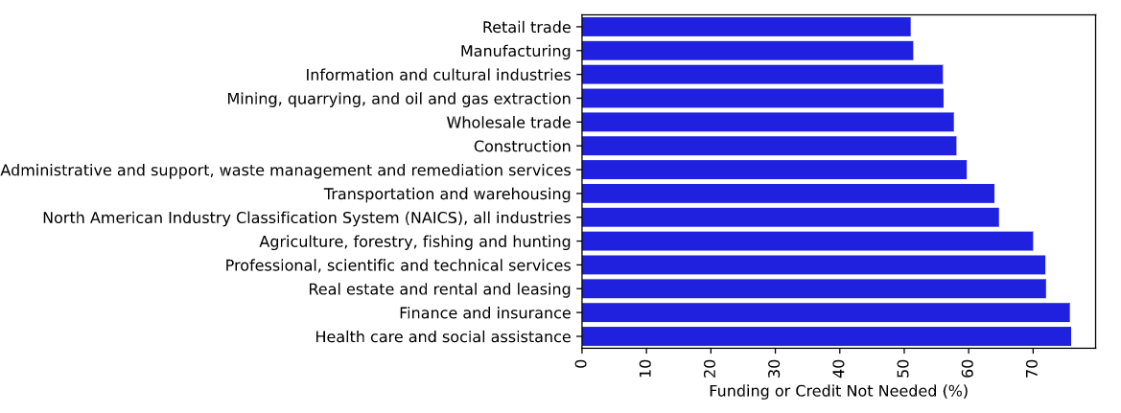
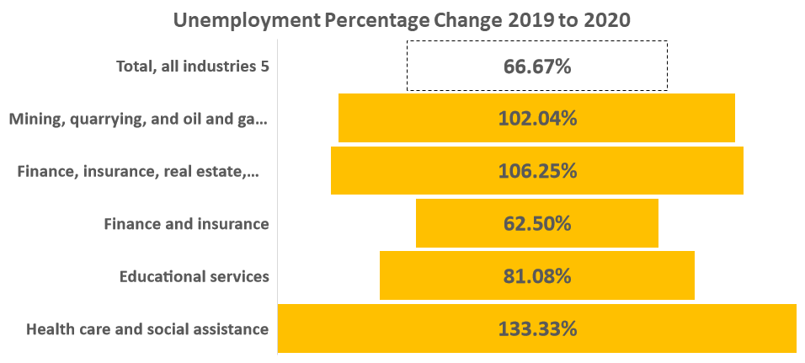
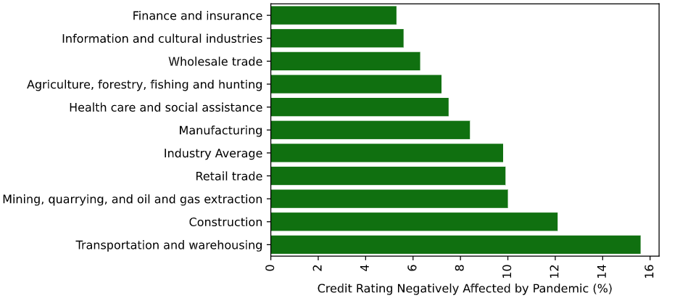
Social/Governance (Credit)
Key Insights
Funding Needs by Industry 2020 (Survey)
Healthcare, finance, and oil industry all were above average in terms of layoffs during the pandemic.
However, the both finance and healthcare were not in need of extra funding or credit.
Oil industry reportedly also suffered from the pandemic in terms of credit rating and are in need of funding.
More covenants and potential litigation from laborers.
Unemployment Percentage Change 2019-2020
Credit Rating Decrease Due to Pandemic (Survey)
Background
Background
Environment
Approach
Social
Environment
Governance
Social
Other
Governance
Conclusion
Conclusion
Notes:
Sources: Impact on credit rating due to the pandemic, by business characteristics, second quarter of 2021, Reasons business or organization did not access any funding or credit due to the COVID-19 pandemic, by business characteristics, second quarter of 2021

Slide 6
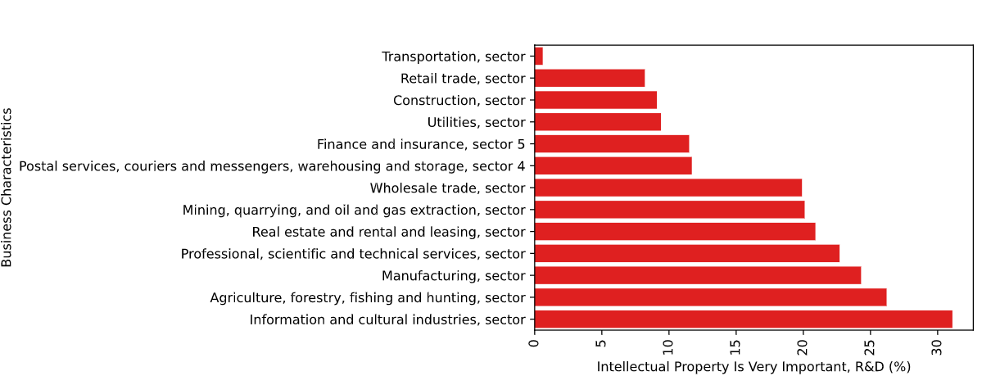
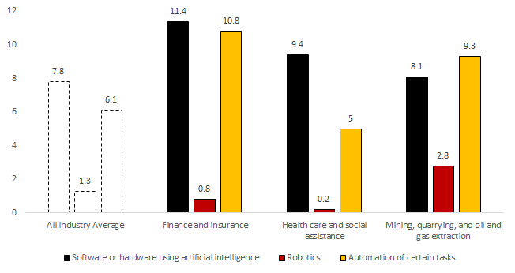
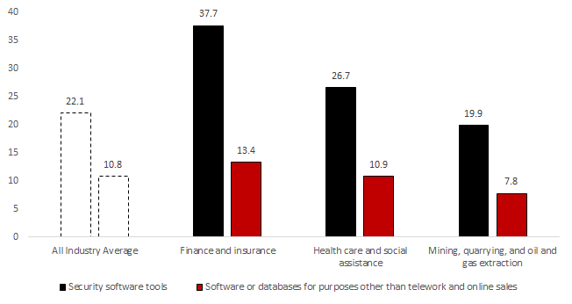
Governance (New Tech)
Key Insights
Importance of IP per Industry 2019
Oil, finance, and health care industries are shown to invest above average in new technologies and cares about new IP.
However, Oil does not invest sufficiently in cybersecurity and database software.
Likelihood of data breaches and hacks increase leading to potential litigation.
Need for patenting and certification due to IT investment.
Investment In IT 2021 (Survey)
Investment in Security 2021 (Survey)
Background
Background
Environment
Approach
Social
Environment
Social
Other
Governance
Conclusion
Governance
Conclusion
Notes:
Sources: Technologies the business or organization plan to adopt or incorporate over the next 12 months, by business characteristics, second quarter of 2021, Importance of IP by Industry
Extra point-invesitng in automation will lead to less flexibility for laborers

Slide 7
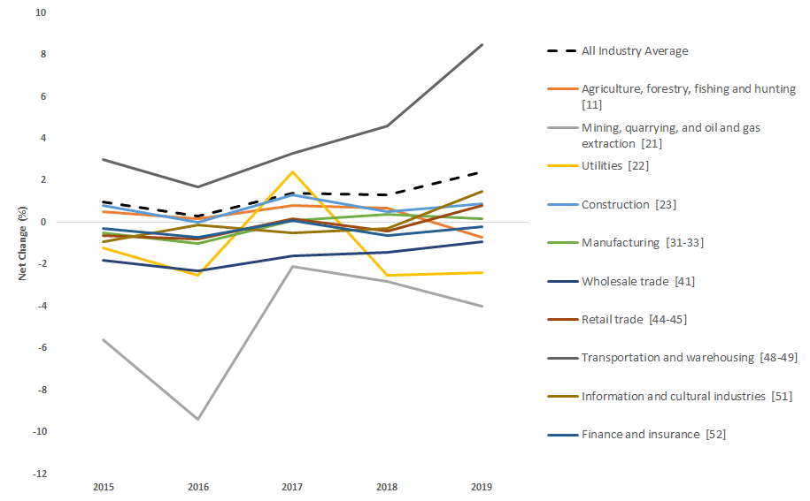
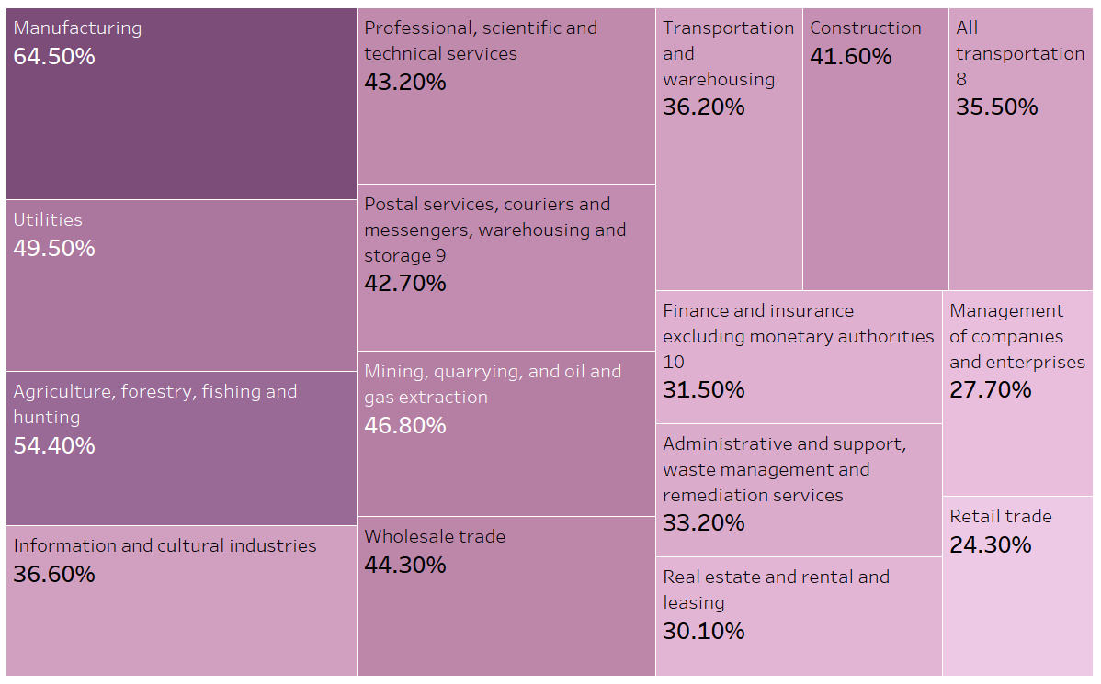
Governance (Competition)
Market Entry-Exit Net Change
Quality Management Practices 2019 (Survey)
Key Insights
Oil and finance industry are shown to be below all industry average when it comes net change in entry and exit of the market.
Both have more companies exiting than entering the market reducing competition.
Competition Bureau of Canada is more likely to intervene to promote a competitive market.
Quality Management deals with certifications and improving general quality management systems.
Background
Background
Environment
Approach
Social
Environment
Governance
Social
Other
Governance
Conclusion
Conclusion
Notes:
Sources: Business Dynamics by Industry, Regular use of business practices, by industry and enterprise size

Slide 8
Conclusion
General Findings and Legal Work Created
Statistics Canada Data Limitations
Findings
Environment: Canada’s 2030 CO2 target will affect the Oil industry
Social: Large layoffs and lack of need for funding leads to poor labor relations
Governance: Investment in new IT except cybersecurity and potential monopolistic business practices
Legal Work
Environment: New regulations (carbon tax, transparency acts)
Social: Litigation from Unions, Contract Renegotiations
Governance: Certification, Competition Bureau Audits, Defaults due to Credit Rating, and Patents for New Technologies
Some datasets have confidential data that can be considered missing.
No benchmark variable for litigation or legal work.
Lack of current data and time series datasets.
Data quality fluctuates (good vs very good).
Additional Data Sources
Dataset | Reasoning
Stock Prices | To compare industries to S&P 500 benchmark and determine business cycle status.
Contingent Liability Data | Represents expected monetary value of potential lawsuits, which could quantify legal work to an extent.
Canadian Priority Survey | Survey on Canadians on what issues they care about the most (e.g. climate change, economy etc). Can measure change in priorities.
Background
Background
Environment
Approach
Social
Environment
Governance
Social
Other
Governance
Conclusion
Conclusion
Notes:
GTA Bank is a start-up bank, providing digital service through mobile app or its downtown branch. Its primary objective is to grow significantly a profitable and stable customer base over the next 5 years. It is to say, GTA Bank wants to grow a loyal, engaged, and high cross-selling customer groups. To achieve the goal, it will use Customer Relationship Management (CRM) to attract, convert engage, retain its customers, which we will be discussing today.
But why CRM? It is important for GTA Bank to establish a good CRM practice in order to compete with increasing competition (with small FinTech and large tech new entrants), tailored to the growing trend in personalized experience & build long-term customer relationship, and work better for the new generation Millennials.

Slide 9
Appendix

Slide 10
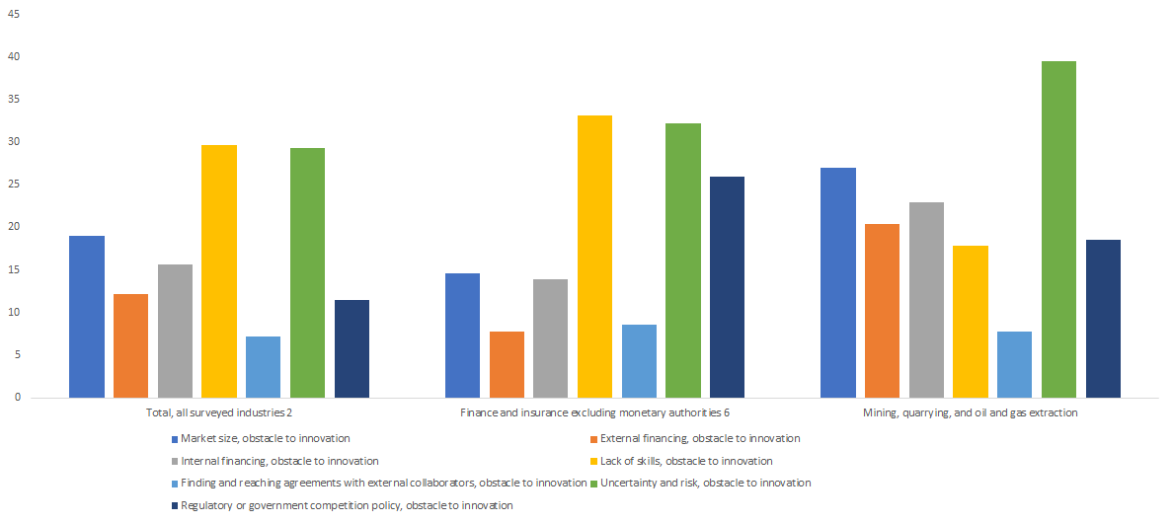
Appendix (Barriers to Entry)
Obstacle for Innovation
Background
Environment
Social
Governance
Other
Conclusion
Notes:
Barriers to Innovation are similar to Barriers to Entry to an extent

Slide 11
Appendix (Barriers to Entry)
Regular Business Activities
North American Industry Classification System (NAICS) | Product development and control management practices 2 | Quality management practices 3 | Other business practices 4 | Regular use of any business practices 5
Total, all surveyed industries 6 | 21.2 | 41.3 | 18.1 | 48.5
Agriculture, forestry, fishing and hunting | 7.6 | 54.4 | 19.2 | 58.6
Mining, quarrying, and oil and gas extraction | 23.1 | 46.8 | 20.1 | 53.1
Utilities | 43.5 | 49.5 | 35.5 | 64.9
Construction | 17.7 | 41.6 | 6.9 | 44.5
Manufacturing | 42 | 64.5 | 27.6 | 72.5
Total, selected services industries 7 | 16.9 | 33.8 | 18.1 | 42
Management of companies and enterprises | 14 | 27.7 | 17.3 | 33.5
Background
Environment
Social
Governance
Other
Conclusion
Notes:
Barriers to Innovation are similar to Barriers to Entry to an extent
To reduce response burden on small businesses, only enterprises with at least 20 employees and revenues of at least $250,000 were considered for sample selection.

Slide 12

Appendix (Case Study)
Case Study
Background
Environment
Social
Governance
Other
Conclusion

